Slide 1

Three Layers of Compute..
Virtual server instances in the cloud

Slide 2

Three Layers of Compute..
Virtual server instances in the cloud
Services for running Docker containers

Slide 3

Three Layers of Compute..
Virtual server instances in the cloud
Services for running Docker containers
Serverless execution in response to events

Slide 4

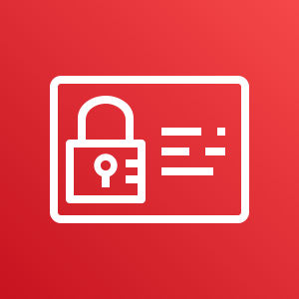
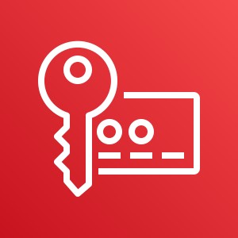

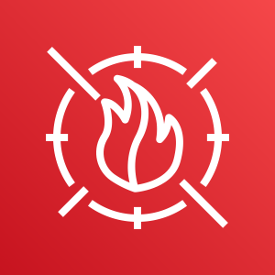

AWS Security Services (Preventative)
AWS Control Tower
AWS Identity and Access Management
AWS Key Management Service
AWS Shield
AWS WAF
AWS Well-Architected Tool

Slide 5
AWS Security Services (Preventative)
AWS Control Tower
AWS Identity and Access Management
AWS Key Management Service
AWS Shield
AWS WAF
AWS Well-Architected Tool

Slide 6
AWS Security Services (Preventative)
AWS Control Tower
AWS Identity and Access Management
AWS Key Management Service
AWS Shield
AWS WAF
AWS Well-Architected Tool

Slide 7
AWS Security Services (Preventative)
AWS Control Tower
AWS Identity and Access Management
AWS Key Management Service
AWS Shield
AWS WAF
AWS Well-Architected Tool

Slide 8






AWS Security Services (Detective)
AWS Security Hub
AWS CloudTrail
Amazon CloudWatch
Amazon GuardDuty
AWS Config
AWS Trusted Advisor

Slide 9
AWS Security Services (Detective)
AWS Security Hub
AWS CloudTrail
Amazon CloudWatch
Amazon GuardDuty
AWS Config
AWS Trusted Advisor

Slide 10
AWS Security Services (Detective)
AWS Security Hub
AWS CloudTrail
Amazon CloudWatch
Amazon GuardDuty
AWS Config
AWS Trusted Advisor

Slide 11
AWS Security Services (Detective)
AWS Security Hub
AWS CloudTrail
Amazon CloudWatch
Amazon GuardDuty
AWS Config
AWS Trusted Advisor

Slide 12
AWS Security Services (Detective)
AWS Security Hub
AWS CloudTrail
Amazon CloudWatch
Amazon GuardDuty
AWS Config
AWS Trusted Advisor

Slide 13
Other Security Activities (App Layer)
What? | Why?
Solution design review | Ensure application design adequately protects valuable resources and information
Threat modeling | Understand attacker & impact of control failures
Security unit tests | Ensure expected security functionality operates as expected
Code review (manual peer review) | Look for malicious code, style and standards
Code scan (static/dynamic) | Look for code vulnerabilities
Penetration testing | Make sure nothing obvious has been missed
Manage risks and vulnerabilities | Ensure that known issues are resolved in a timely manner
Operate solution | Manage and monitor application to identify technical and business anomalies

Slide 14
The Things AWS Isn’t Doing
Protect your customer data and applications with
Configuration of access controls
Configuring encryption
Application monitoring
Intrusion detection/prevention
Application runtime analysis
Backups
Disaster Recovery

Slide 15


Infrastructure Services
Virtual server instances in the cloud
Services for running Docker containers
Serverless execution in response to events

Slide 16
Shared Security Model (Infra Services)
Examples: Amazon EC2, Amazon EBS, and Amazon VPC
Customer Data
Customer IAM
Managed By AWS Customers
Platform & Application Management
Operating System, Network & Firewall Configuration
Client-side encryption
Data integrity
Authentication
Server-side encryption
File system and/or data
Network traffic protection
Encryption, integrity, identity
(Optional) Opaque Data: 0s and 1s
AWS Endpoints
Foundation
Services
AWS IAM
Managed By Amazon Web Services
Compute
Storage
Databases
Networking
AWS Global
Infrastructure
Regions
Availability Zones
Edge Locations

Slide 17


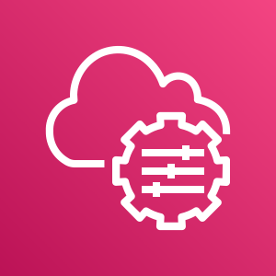
AWS Security Services for Infrastructure
Amazon EC2 Auto Scaling
AWS OpsWorks
AWS Systems Manager
Amazon GuardDuty
AWS Well-Architected Tool
AWS Config
Notes:
Icons: https://thenounproject.com

Slide 18
Container Services
Virtual server instances in the cloud
Services for running Docker containers
Serverless execution in response to events

Slide 19
Shared Security Model (Container Services)
Examples: Amazon ECS, Amazon EKS and AWS Fargate
Customer Data
Customer IAM
Managed By AWS Customers
Application Management
Firewall Configuration
Client-side encryption
Data integrity
Authentication
Server-side encryption
File system and/or data
Network traffic protection
Encryption, integrity, identity
(Optional) Opaque Data: 0s and 1s
Operating System, Network & Platform Management
AWS IAM
Managed By Amazon Web Services
AWS Endpoints
Foundation
Services
Compute
Storage
Databases
Networking
AWS Global
Infrastructure
Regions
Availability Zones
Edge Locations

Slide 20
Container Services
Select, install, configure, harden, patch, monitor, perform break/fix, upgrade and eventually decommission:
Container assembly
Application dependencies (example: NodeJS packages)
Business application
Notes:
Icons: https://thenounproject.com

Slide 21
AWS Security Services for Containers
Amazon EC2 Auto Scaling
AWS OpsWorks
Amazon GuardDuty
AWS Config
AWS Well-Architected Tool
Notes:
Icons: https://thenounproject.com

Slide 22
Abstract / Serverless Services
Virtual server instances in the cloud
Services for running Docker containers
Serverless execution in response to events

Slide 23
Shared Security Model (Serverless Services)
Examples: AWS Lambda, Amazon S3 and Amazon DynamoDB
Customer Data
AWS IAM
Managed By AWS Customers
(Optional) Opaque Data: 0s and 1s
Client-side encryption, data integrity and authentication
Server-side encryption provided by the platform
Managed By Amazon Web Services
Network traffic protection provided by the platform
Platform & Application Management
Operating System, Network & Firewall Configuration
AWS Endpoints
Foundation
Services
Compute
Storage
Databases
Networking
AWS Global
Infrastructure
Regions
Availability Zones
Edge Locations

Slide 24
AWS Security Services for Serverless
Amazon GuardDuty
AWS Config
AWS Well-Architected Tool
Notes:
Icons: https://thenounproject.com

Slide 25
High-level Services Are Better
Serverless
Containers
Infrastructure
Notes:
Icons: https://thenounproject.com

Slide 26



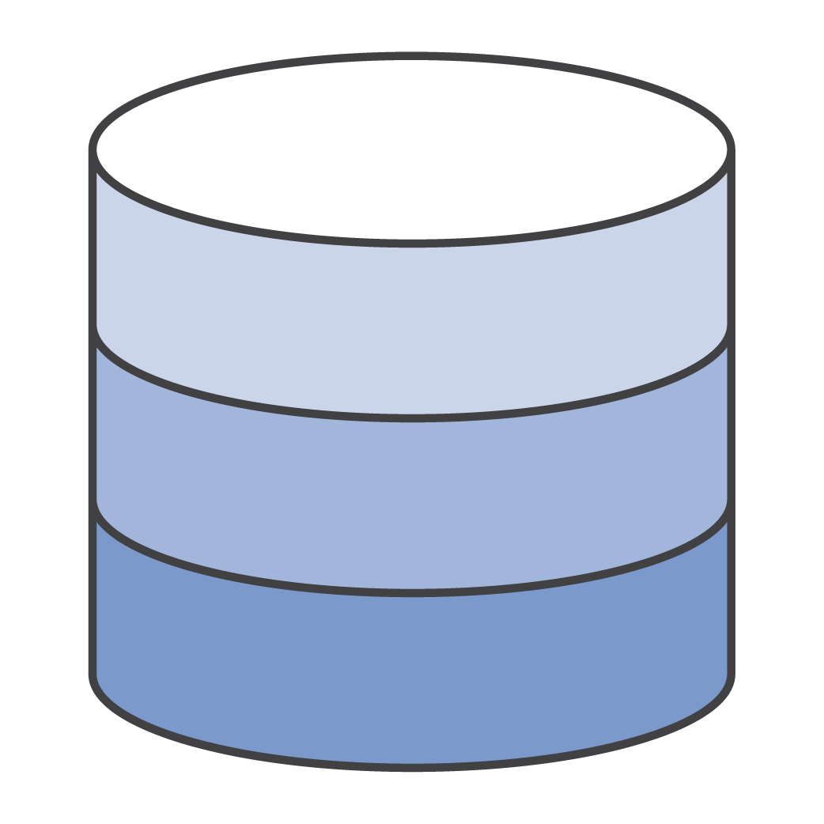

AWS Security Solutions
Detective control
Infrastructure security
Data protection
Incident response
Identity
AWS Identity & Access Management (IAM)
AWS Organizations
AWS Cognito
AWS Directory Service
AWS Single Sign-On
AWS Security Hub
AWS CloudTrail
AWS Config
Amazon CloudWatch
Amazon GuardDuty
VPC Flow Logs
AWS Control Tower
Amazon EC2 Systems Manager
AWS Shield
AWS Web Application Firewall (WAF)
Amazon Inspector
Amazon Virtual Private Cloud (VPC)
AWS Key Management Service (KMS)
AWS CloudHSM
Amazon Macie
Certificate Manager
Server Side Encryption
AWS Config Rules
AWS Lambda

